Slide 1
Employee Data Analysis using Excel
STUDENT NAME : OJASWINI.R
REGISTER NO : 312217019(C967AB07884759EB85E48AED3F3A53E1)
Department. : B.Com(General)-B
college. : Shri krishna swamy college for women.

Slide 2
PROJECT TITLE
CREATING AN EMPLOYEE PERFORMANCE SCORECARD IN EXCEL.

Slide 3


AGENDA
Problem Statement
Project Overview
End Users
Our Solution and Proposition
Dataset Description
Modelling Approach
Results and Discussion
Conclusion
3/21/2024 Annual Review

Slide 4

PROBLEM STATEMENT
1.Identify Key Performance Indicators (KPIs)
2.Design the Scorecard Layout:
3.Set Performance Targets and Ratings:
4.Automate Calculations
5.Data Input and Review Process
6.Performance Summary and Analysis
7.Continuous Improvement and Feedback

Slide 5

PROJECT OVERVIEW
•Develop a comprehensive scorecard to assess employee performance.
•Select relevant KPIs for different roles, such as productivity, quality, attendance, and teamwork.
•Create a user-friendly layout with separate sections for each KPI.
•Use Excel formulas to automate score calculations and overall ratings.
•Develop a clear process for regular data entry and review by managers.

Slide 6

WHO ARE THE END USERS?
1.Managers and Team Leads
2.Human Resources (HR) Personnel
3.Employees
4.Senior Management
5.Performance Review Committees

Slide 7

OUR SOLUTION AND ITS VALUE PROPOSITION
•Customizable and User-Friendly Design
•.Automated Performance Evaluation
•Data-Driven Insights
•Facilitates Transparent Feedback and Communication
•Supports Continuous Improvement

Slide 8
Dataset Description
•Employee Information
•Performance Period
•Key Performance Indicators (KPIs)
•Performance Scores
•Attendance and Punctuality Data

Slide 9

THE "WOW" IN OUR SOLUTION
•Customizable to Fit Any Organization
•Interactive Dashboard with Visual Insights
•Automated Scoring and Analysis
•User-Friendly Interface with Clear Navigation
•Continuous Improvement with Feedback Loops
3/21/2024 Annual Review
9

Slide 10
MODELLING
•Organize the Excel workbook into different sheets, such as "Data Entry," "Scorecard," and "Dashboard," for clear data separation and navigation.
•Identify and categorize key performance indicators (KPIs) relevant to each role and department.
•Apply Excel formulas like SUM, AVERAGE, and IF to automate calculations for scores and weighted averages.
•Design charts and graphs to visually represent performance data on the "Dashboard" sheet, such as bar charts for scores and pie charts for performance distribution.
•Protect cells with formulas and sensitive data to prevent accidental changes.
10

Slide 11
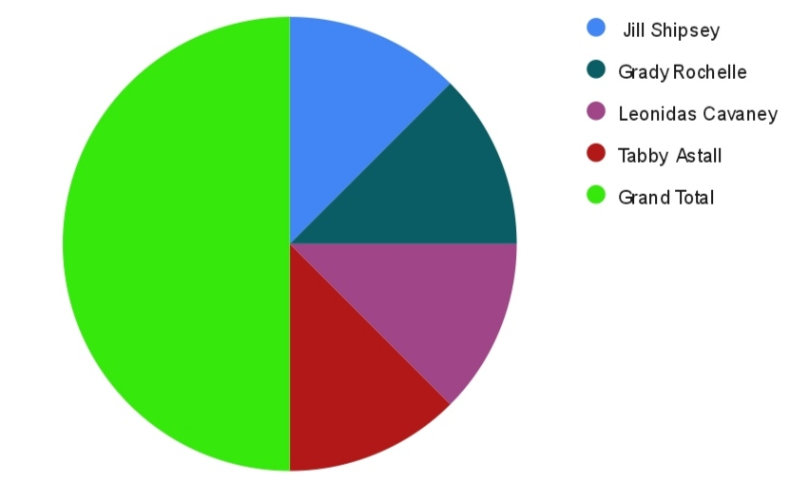
RESULTS
11

Slide 12
conclusion
•Using Excel to create an Employee Performance Scorecard is an effective and practical approach for managing employee performance. The scorecard helps organizations track performance consistently, provides clear insights for better decision-making, and fosters transparency and fairness in evaluations. It also supports employee growth by identifying strengths and areas for improvement, all while being cost-effective and easy to implement. Overall, this tool can greatly enhance both individual and organizational performance.

